Slide 1
A Statistical Analysis of UA WiFi Network Speed
STAT 571B – May 1, 2017
Cameron Dorsett, Goutham Gunanjipalli, Kensaku Okada
Notes:
Cameron

Slide 2
Background & Introduction
The Experiment:
Does UA WiFi Network Speed change with respect to location, time, day of the week, and device?
Meetings with University Information Technology Services (UITS)
Understanding of UA WiFi Network Structure
Data Collection
iPerf- network bandwidth measurement tool
Notes:
Cameron

Slide 3
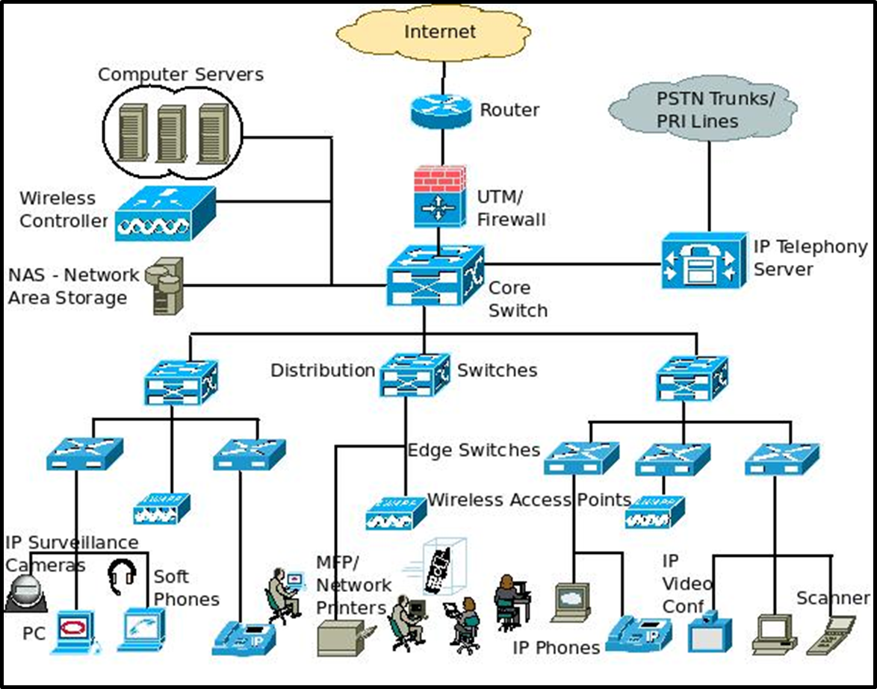
An Overview: UA WiFi Network Infrastructure
Network Core: 3 Cisco routers/servers
Access to the internet for U of A
Distribution routers
Backup/secure the network core in case of connection failure
Switches
Connect individual devices to routers and internet
Access Points (APs)
Connect to switches
Allow devices to access wirelessly
9400 around campus
IEEE 802.11 WiFi standards
Specific to device and AP
802.11AC – Shantz & Forbes
A, B, G, N, AC, etc.
Notes:
Goutham

Slide 4
Design of Experiment
Factorial Design
24 Total Combinations of Treatments
Treatment Factors
1st Treatment- Location, 3 levels: Forbes Basement, Shantz 440, Main Library
2nd Treatment- Day, 2 levels: Sunday & Friday
3rd Treatment- Time, 2 levels: 9 am & 4 pm
4th Treatment- Who’s PC?, 2 levels: Goutham & Cameron
40 replications/treatment (10 reps/reading * 4 readings/treatment)
Observing network speed (bandwidth) @ units of [Mbits/s] via iPerf
Notes:
Goutham

Slide 5
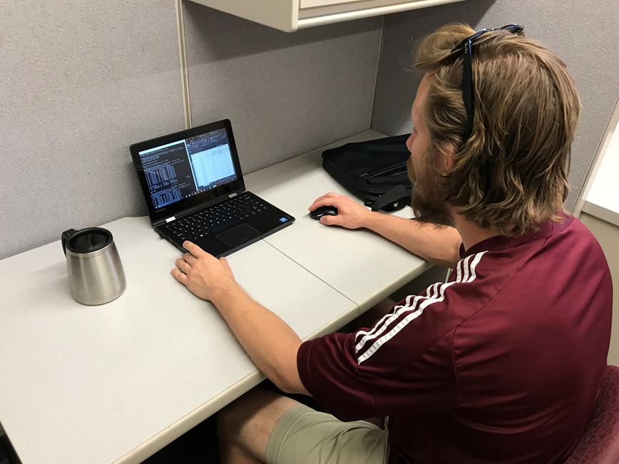
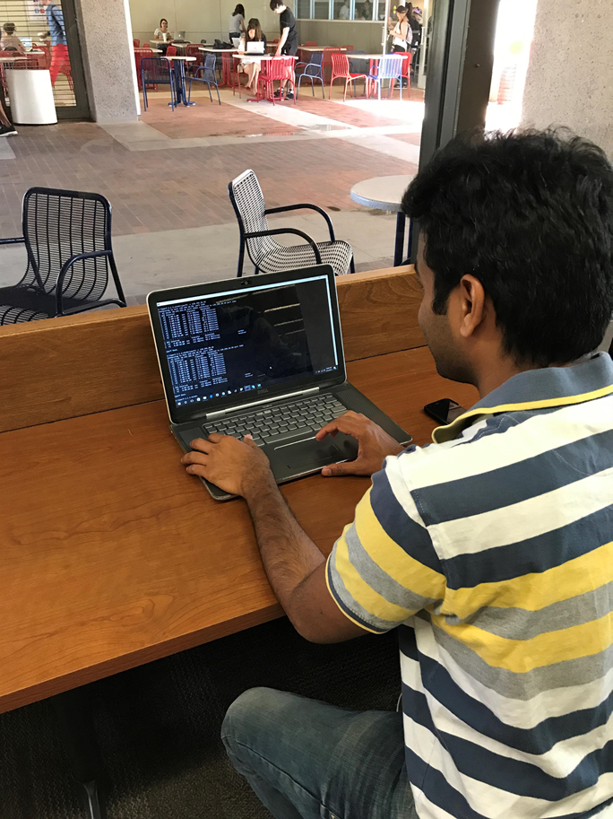
Methodology: iPerf
Simulates Client/Server interaction
Kensaku: Server
Goutham & Cameron: Client
Provides network bandwidth readings
[Mbit/s]
Data collection according to design
Notes:
Goutham

Slide 6
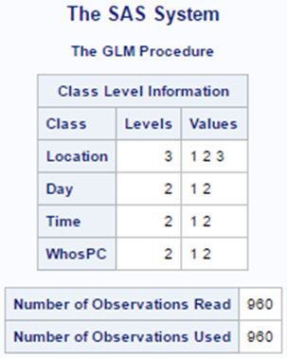
Methodology: SAS
Full Factorial Design chosen to study interactions between all treatment factors
Nuisance factors eliminated through iPerf and design of experiment
Ex(s): distance from APs, location of server, network path
Response variable: network speed [Mbits/s]
Notes:
Goutham

Slide 7
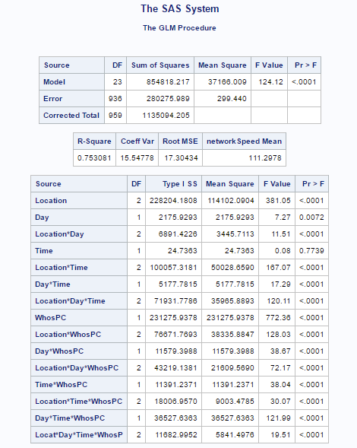
ANOVA & P-value Tables
Notes:
Cameron

Slide 8
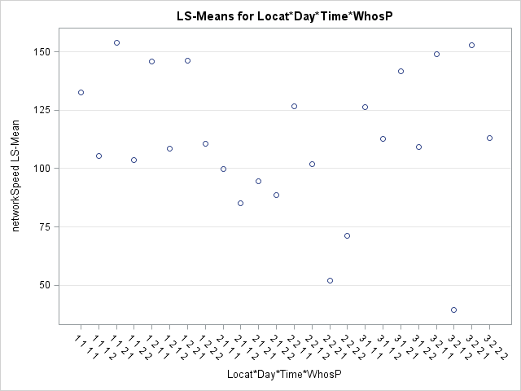
SAS Results
Based on the plot we can infer:
Main library had slowest network speed on Sunday evening
Outlier:
Sunday morning
Shantz 440
Cameron’s PC
Average network speed: 111.3 [Mbits/s]
Notes:
Cameron

Slide 9
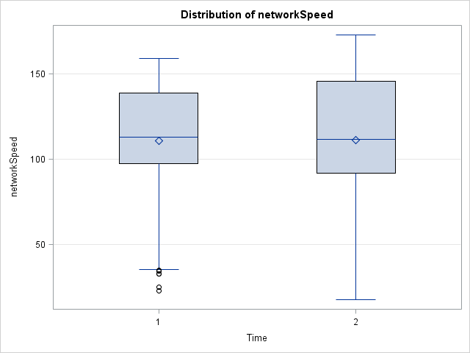
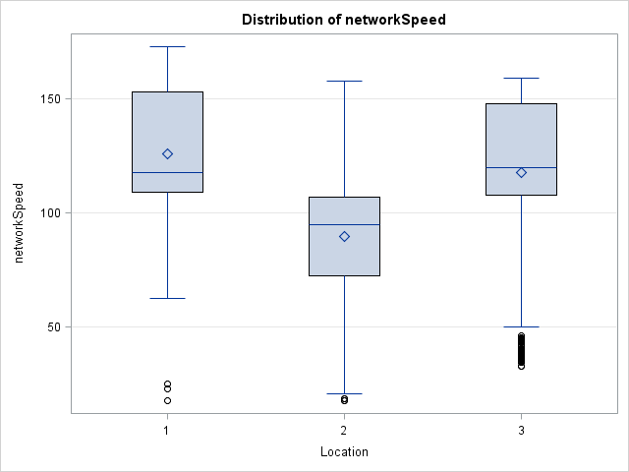
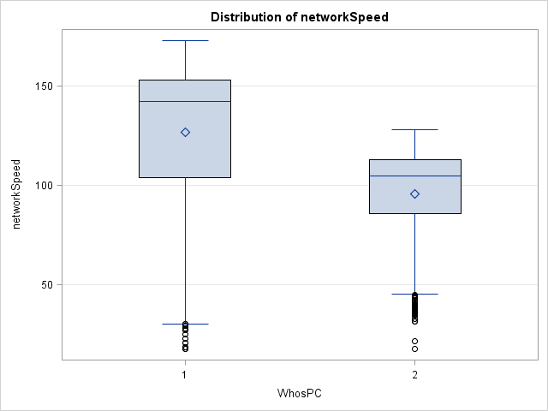
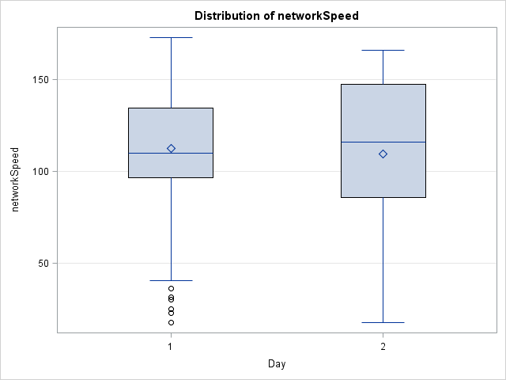
Notes:
Cameron/Goutham

Slide 10
Conclusions & Recommendations
All interactions of treatment factors statistically significant except for Time
Among 3 Locations:
Shantz slowest speed
Forbes basement slightly greater than Main Library
Time with little influence on speed; same can be said for Day
Who’s PC? – PC had greater influence on network speed
Ex(s): processing speed, WiFi module, etc.
Notes:
etc

Slide 11
Questions & References
Questions?
Special thanks to Dr. An, UITS team, and Brian Little
Notes:
etc

